Slide 1



🏡 Real Estate Website: Modern & seamless rent and brokerage web.
Looking to buy your dream home or find the perfect rental? At real estate, we connect buyers, sellers, and renters with the best properties in the market. Whether you're searching for a modern family home, a luxury apartment, or a cozy rental, we have a wide range of listings to suit your needs.
By Jemin kukadiya
Enroll no:-23002171310074
1

Slide 2


Discussion overview :-
About the Project.
Key features.
Whats Next ?(future scope)
Tech Stack.
Challenges & solutions.
2

Slide 3
About the Project
Modern Design
Responsive Layout
Full Functionality
Sleek and user-friendly interface
Optimized for all devices, desktops to mobile
Features include property listings, search filters, user authentication, and client reviews
3

Slide 4
Key Features
Browse detailed property descriptions.
Find properties based on location, type, and price.
Secure login & sign-up system.
Save properties for later viewing.
Fully mobile-friendly design.
Save time and fast working.
Finde affordebal and best price house.
House,Villa,Rent House All are available.
4

Slide 5
Tech Stack
Frontend
Icons & Fonts
CDN Integration
Animations
HTML, Tailwind CSS, JavaScript
Font Awesome, Google Fonts (Poppins)
TailwindCSS & FontAwesome via CDN
JavaScript for smooth interactions
5

Slide 6

Challenges & Solutions
Navigation
Mobile-Friendly
TailwindCSS for consistent structure
Optimized responsiveness
pagination
Pagination for mutipale pages.
6

Slide 7
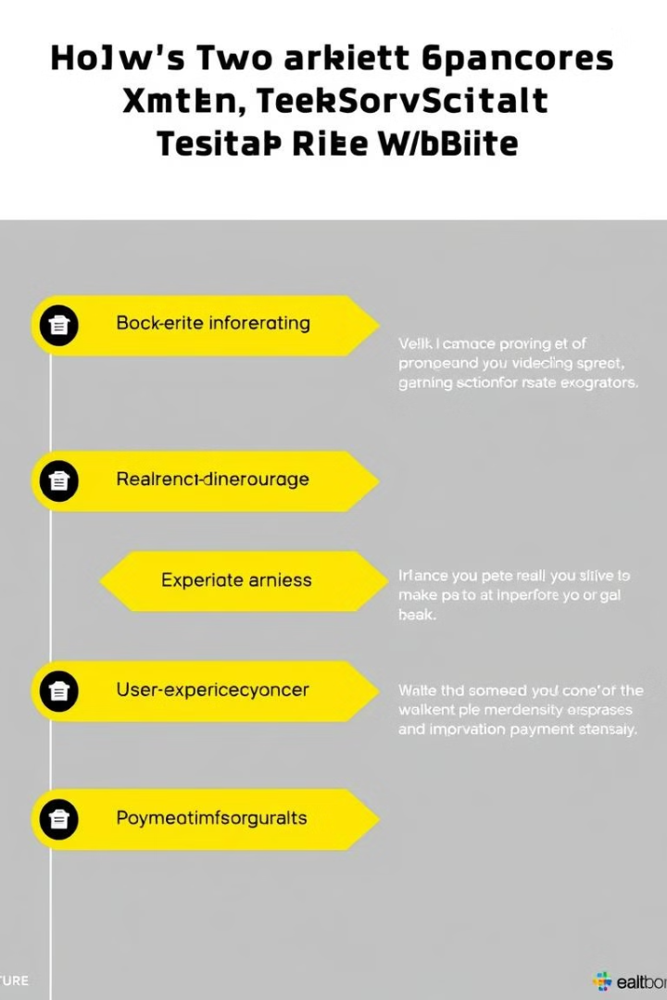

What's Next?
1
Add dynamic backend for property management
2
Enable real-time messaging for seamless communication
3
Improve user experience with more animations and filters
4
Integrate payment gateways for secure transactions
7

